Slide 1

DSA
Lect#8

Slide 2
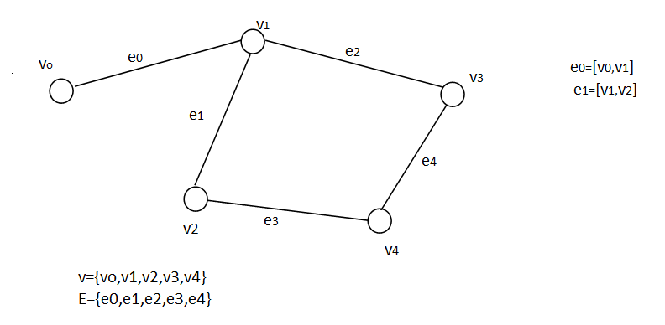
Graph
Graph is a non-linear data structure.

Slide 3
Graph
[ ] square bracket shows unordered pair.
() parenthesis shows ordered pair.

Slide 4

Graph
A graph consists of two things:
A set V of elements called nodes.
A set E of edges such that each edge e in E is identified with a unique (unordered) pair [u,v] of nodes in v, denoted by e=[u,v].
We indicate the pairs of the graph by writing G=(V,E)

Slide 5

Adjacent Nodes
If e=[u,v], then u and v are called adjacent nodes or neighbors.

Slide 6

Degree of node
The degree of node u, written deg(u), is the number of edges containing u.
If deg(u)=0, then u is called isolated node.

Slide 7
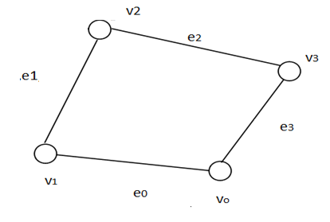
Path
A path of length n from a node u to another node v is defined as a sequence of n+1 nodes.
P=(V0,V1,V2,….,Vn)
The path is said to be closed if V0=Vn

Slide 8
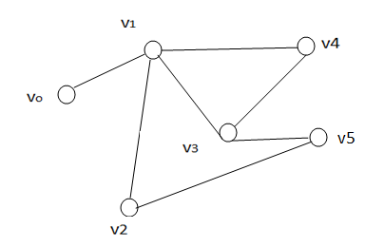
Simple and Complex Path
Simple Path
Complex Path
The path is said to be simple if all the nodes are distinct, with the exception that V0 may equal to Vn (in case of close path) otherwise it is complex path.
{v0,v1,v4,v3,v1,v2,v5,v3}

Slide 9
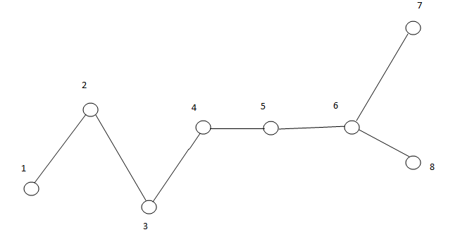
Connected Graph
A graph is said to be connected if there is a path between any two of its nodes.

Slide 10
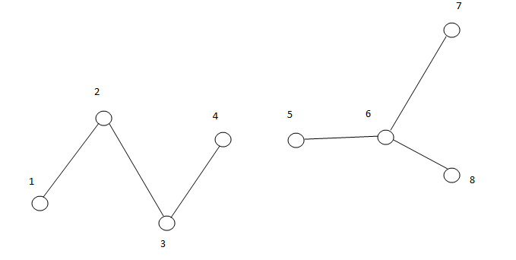
Disconnected Graph
A graph is said to be disconnected if there is no path between even a single pair of nodes.

Slide 11
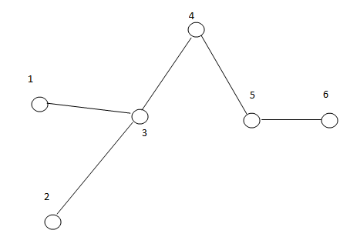
Tree Graph
A connected graph T without any cycle is called a tree graph or free tree or simple a tree.
There is always only one unique simple path P between any two nodes u and v

Slide 12
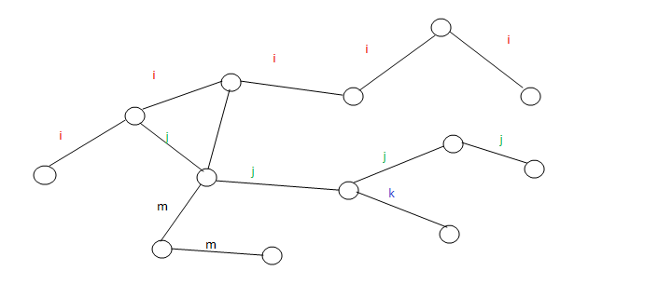
Labelled Graph
A graph is said to be labelled if its edges are assigned data.

Slide 13
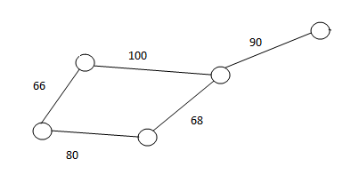
Weighted Graph
A graph G is said to be weighted if each edge e in G is assigned a non-negative numerical value w(e) called the weight or length of e.

Slide 14
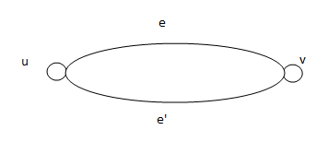
Multiple edges
Distinct edges e and e’ are called multiple edges if they connect the same end points, that is, if e=[u,v] and e’=[u,v].

Slide 15
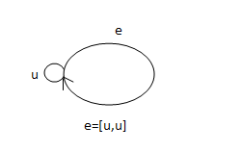
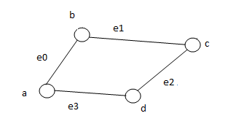
Loop vs cycle
loop
cycle
An edge is called loop if it has identical end points.
In a loop we have only a single edge.
In cycle, we have a same starting and ending nodes but connected with more than a single edge.

Slide 16
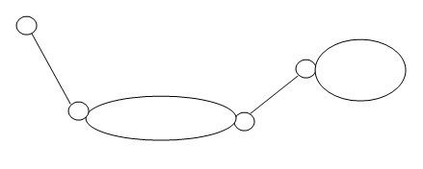
Multi Graph
Multi Graph is a graph consisting of multiple edges and loops

Slide 17


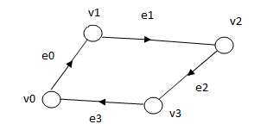
Directed Graph
Also known as digraph.
Edges are represented as arrows pointing from one vertex(node) to another vertex(node).
e=(u,v)
Use parenthesis here for the ordered pair

Slide 18
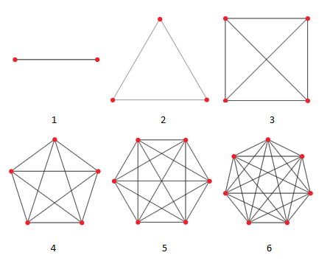
Complete Graph
Where we have an edge between every pair of vertices.
Also known as universal graph or clique.

